Slide 1
Certificate of software engineering (23.5f)
FERNANDO L C D (COCSE235F-039)
FINAL SOFTWARE PRESENTATION
(22-11-2023)

Slide 2
FORMS INCLUDED IN THE PROJECT.
Home Page
Register
Sign Up
Log In
Search
Update
Display
Delete
Wages
Gallery​

Slide 3
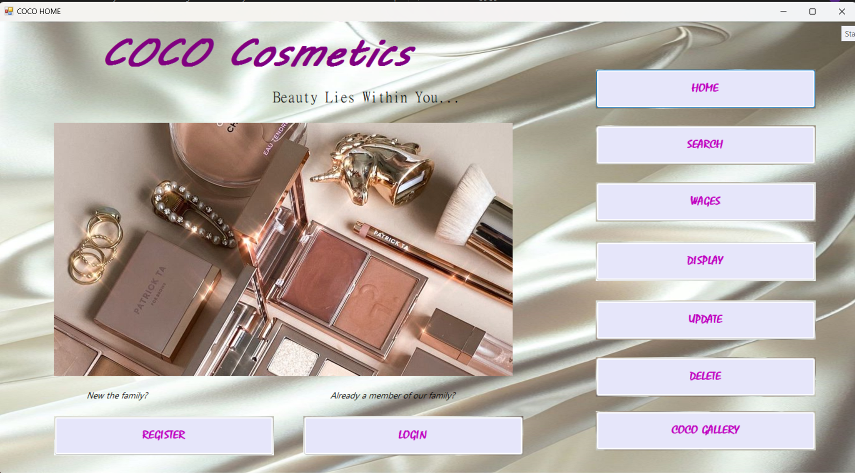
Home page
Any form in the projected system is accessible through the HOME PAGE.

Slide 4
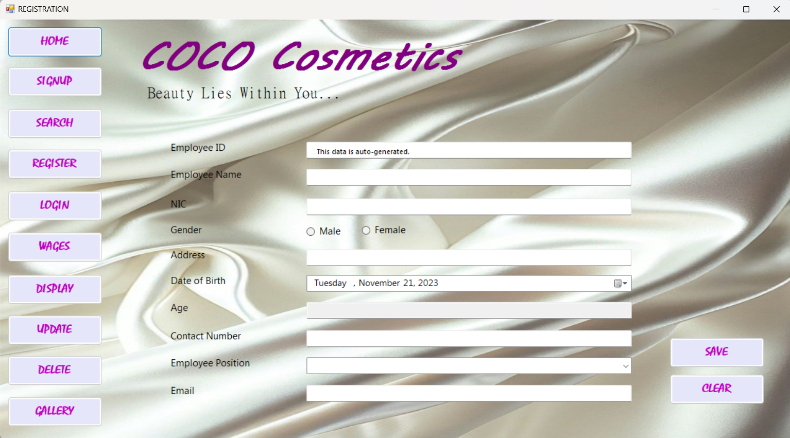
Register
A new employee of the company ‘COCO Cosmetics’ can register into the system

Slide 5
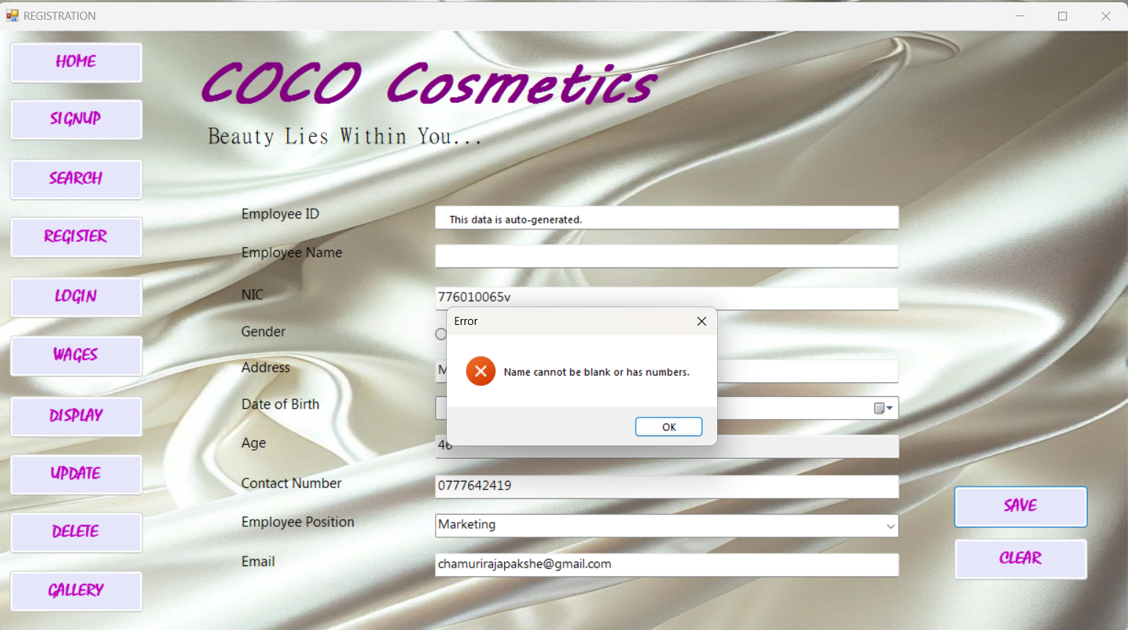
Register errors
The field ‘NAME’ cannot be either blank or have numeric values.

Slide 6

Register errors
The field ‘NIC’ cannot be blank.

Slide 7
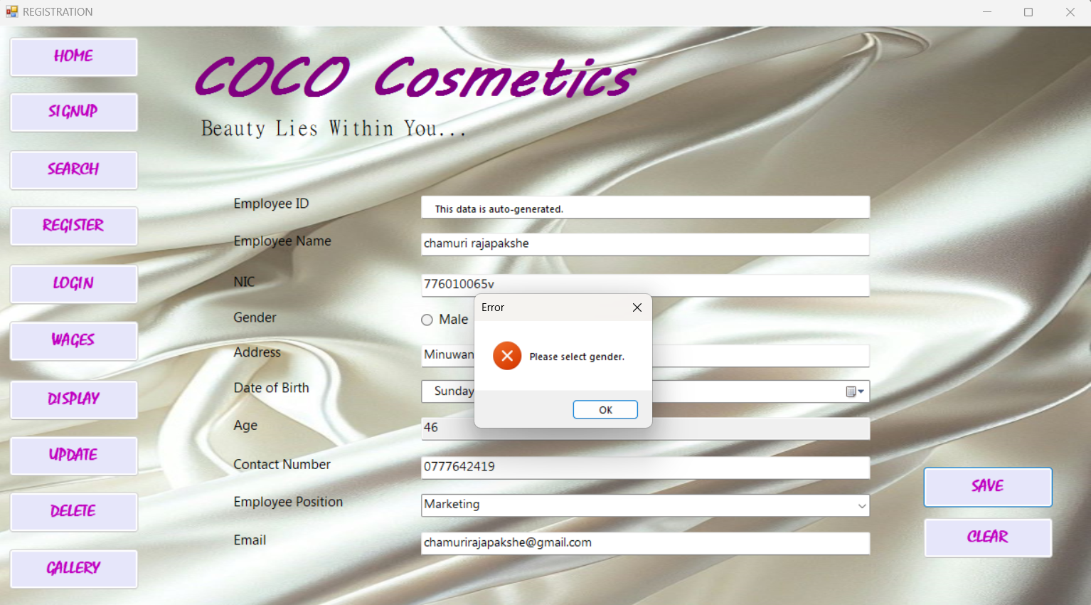
Register errors
The field ‘Gender’ cannot be blank.

Slide 8
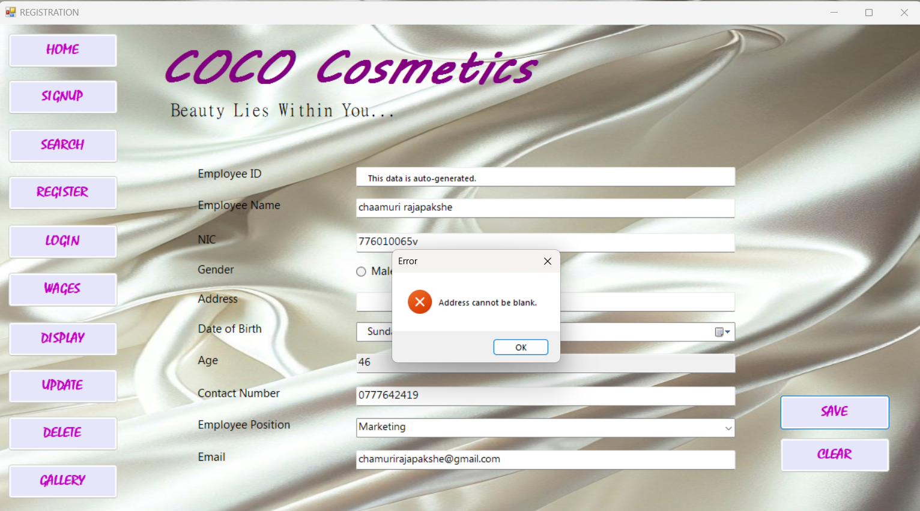
Register errors
The field ‘Address’ cannot be blank.

Slide 9
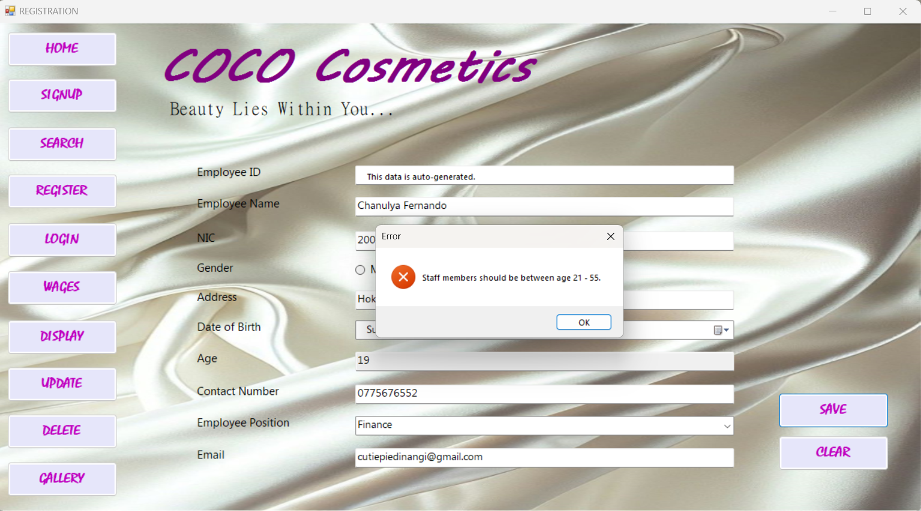
Register errors
Employee cannot be younger than 21 years of age and older than 55 of age.

Slide 10

Register errors
The field ‘Contact Number’ should not have more than 10 numeric values.

Slide 11
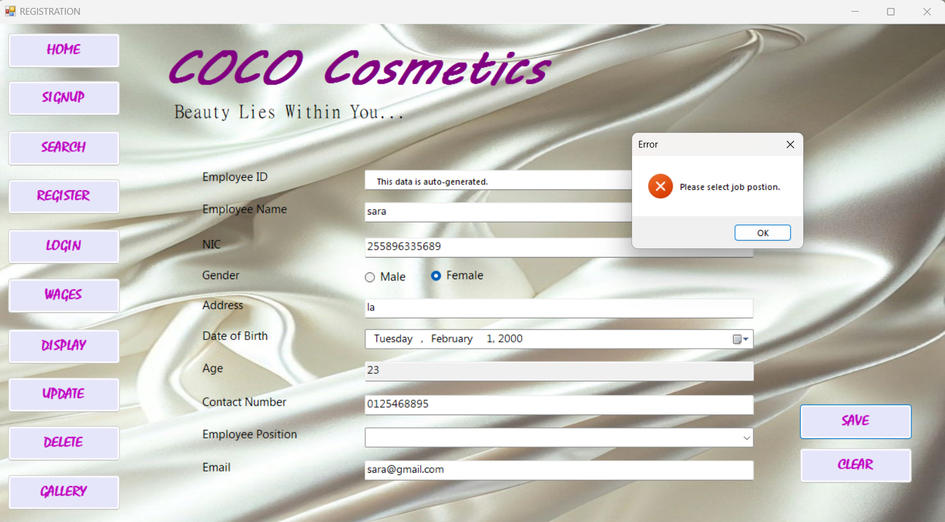
Register errors
The ‘Job Position’ should be selected.

Slide 12

Register errors
The field ‘Email’ should not be kept blank.

Slide 13
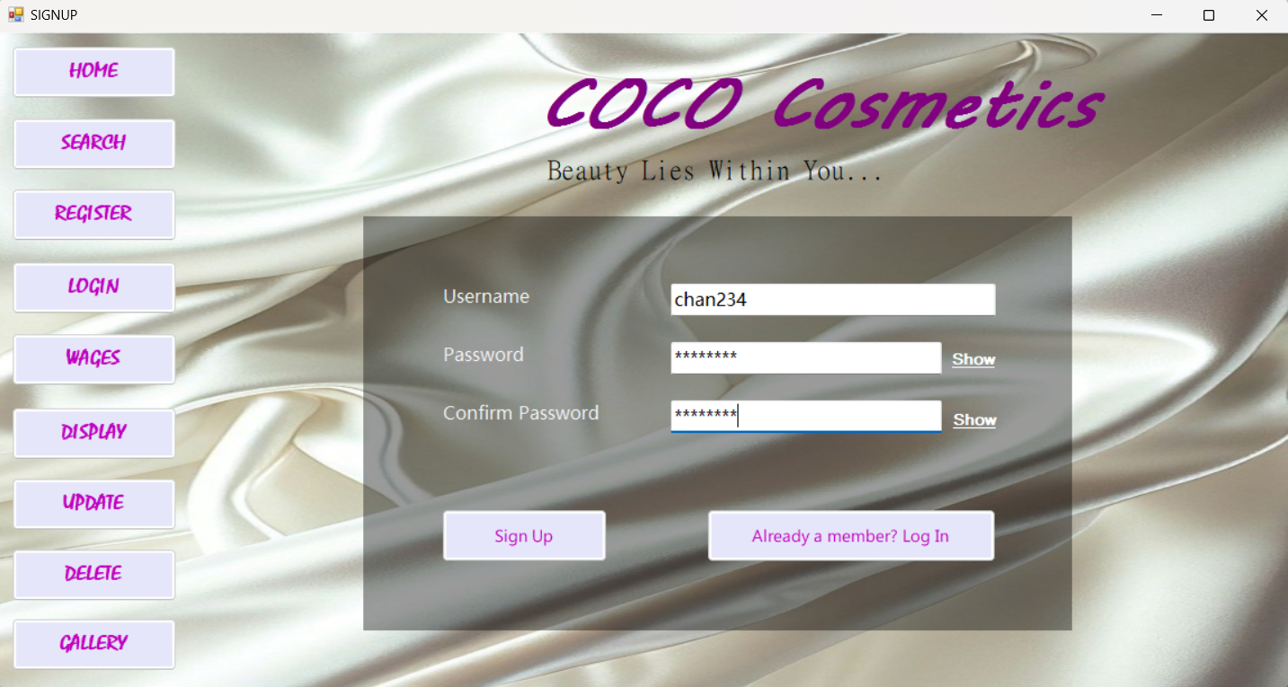

Sign up
Employees registered into the system should sign up in order for them to be able to access the system.

Slide 14
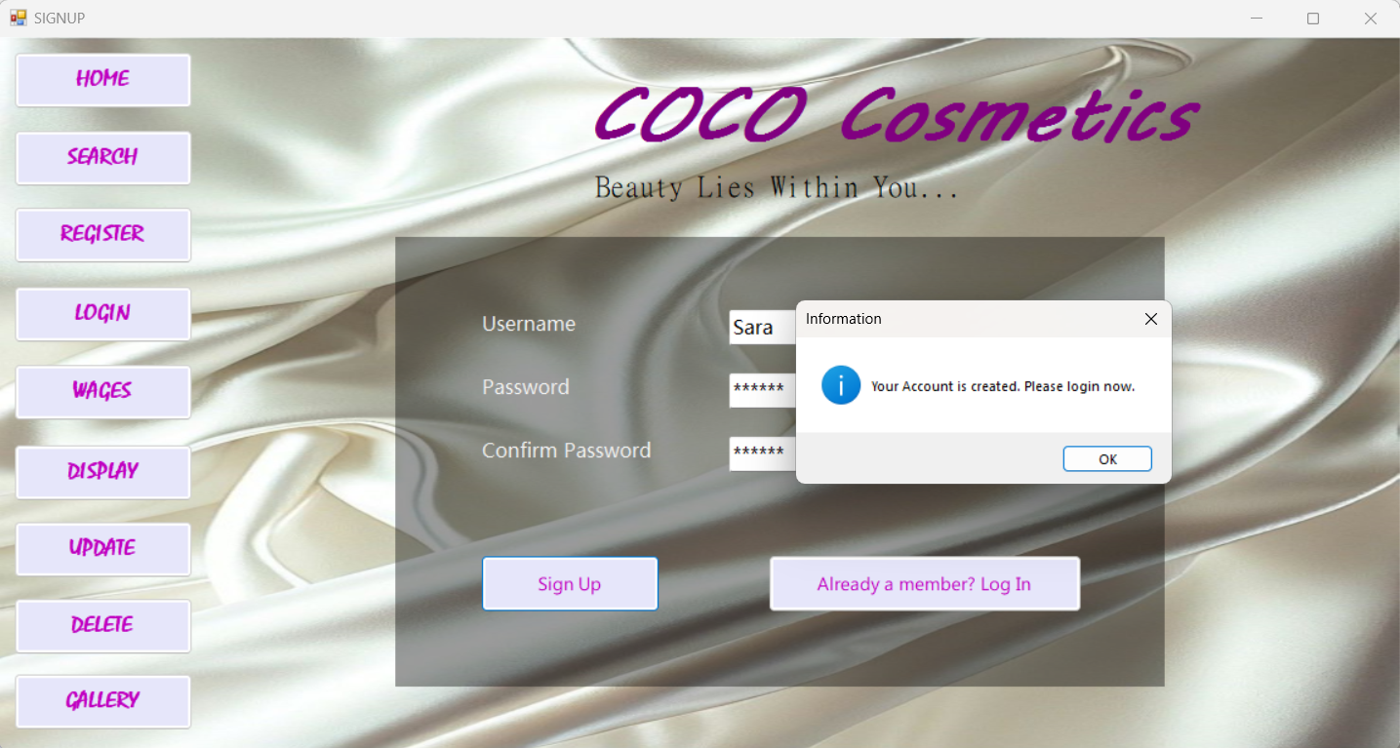
Sign up messages
When the employee successfully signed up into the system.

Slide 15
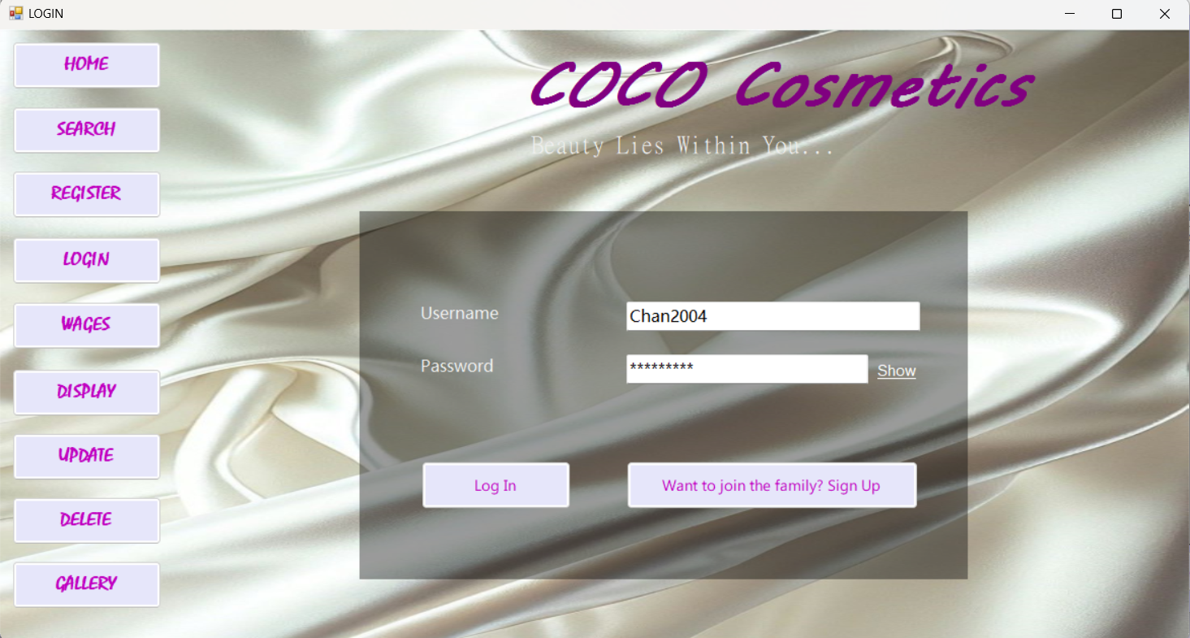
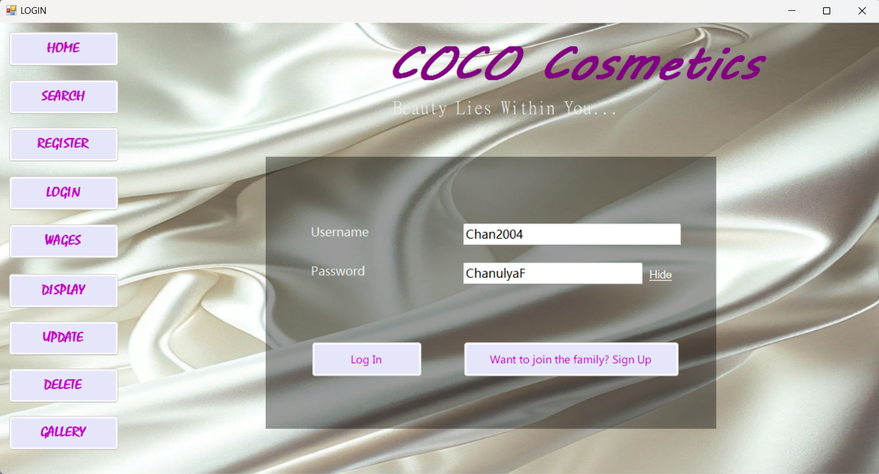
Log in
Employees should log in to the system using ‘username’ and ‘password’ to access the system.

Slide 16
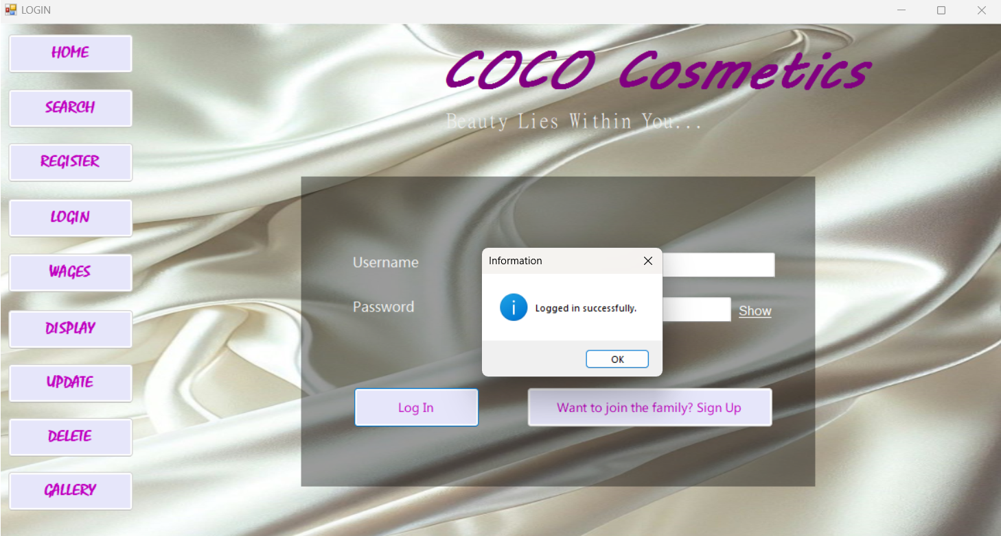
Log in messages
When the employee successfully logged into the system.

Slide 17
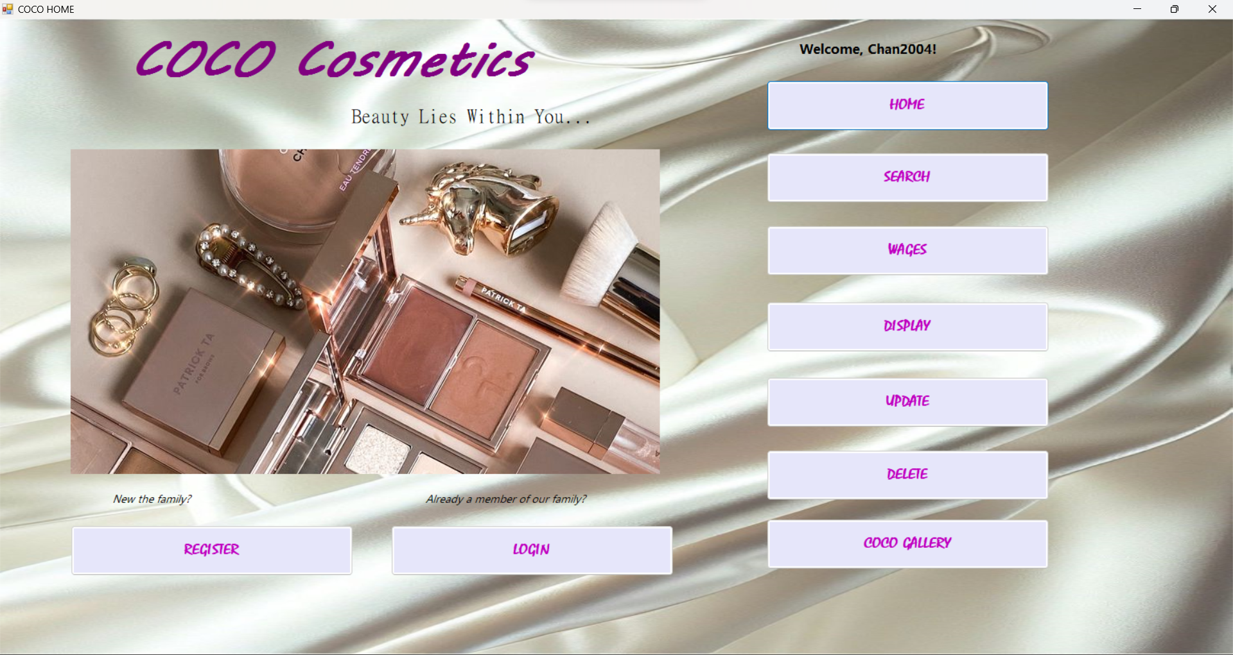
After logging in to the system the user is directed to the home page and their username is displayed in the home page

Slide 18
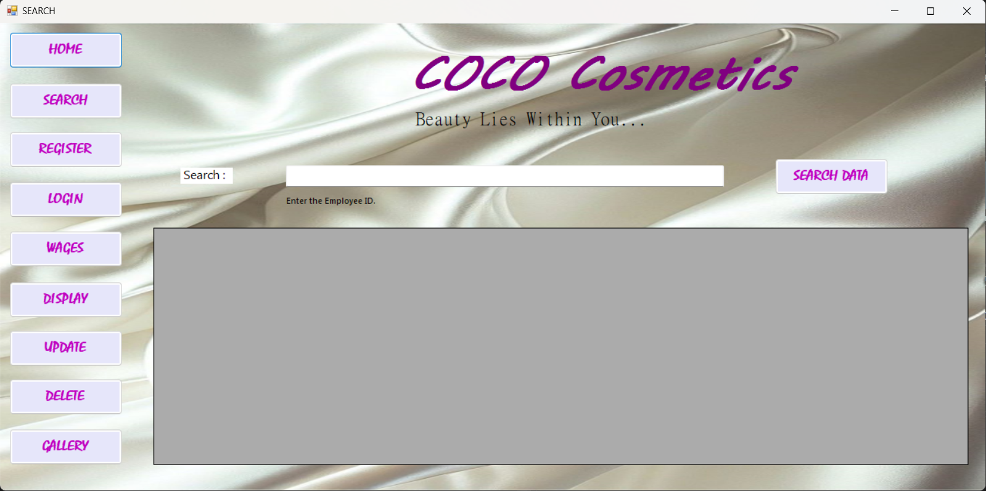
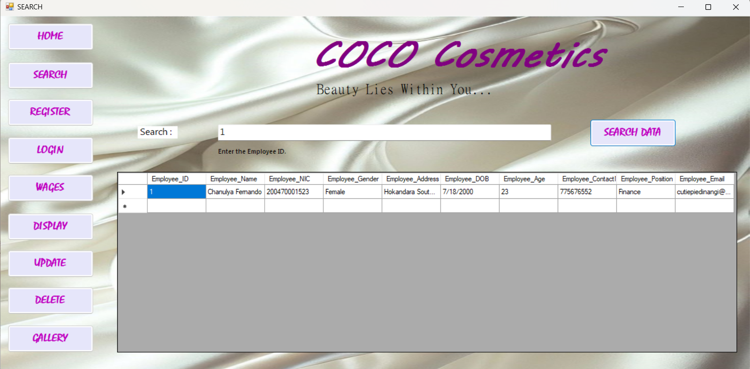
search
Employees can search data by entering the employee ID of their choice.

Slide 19
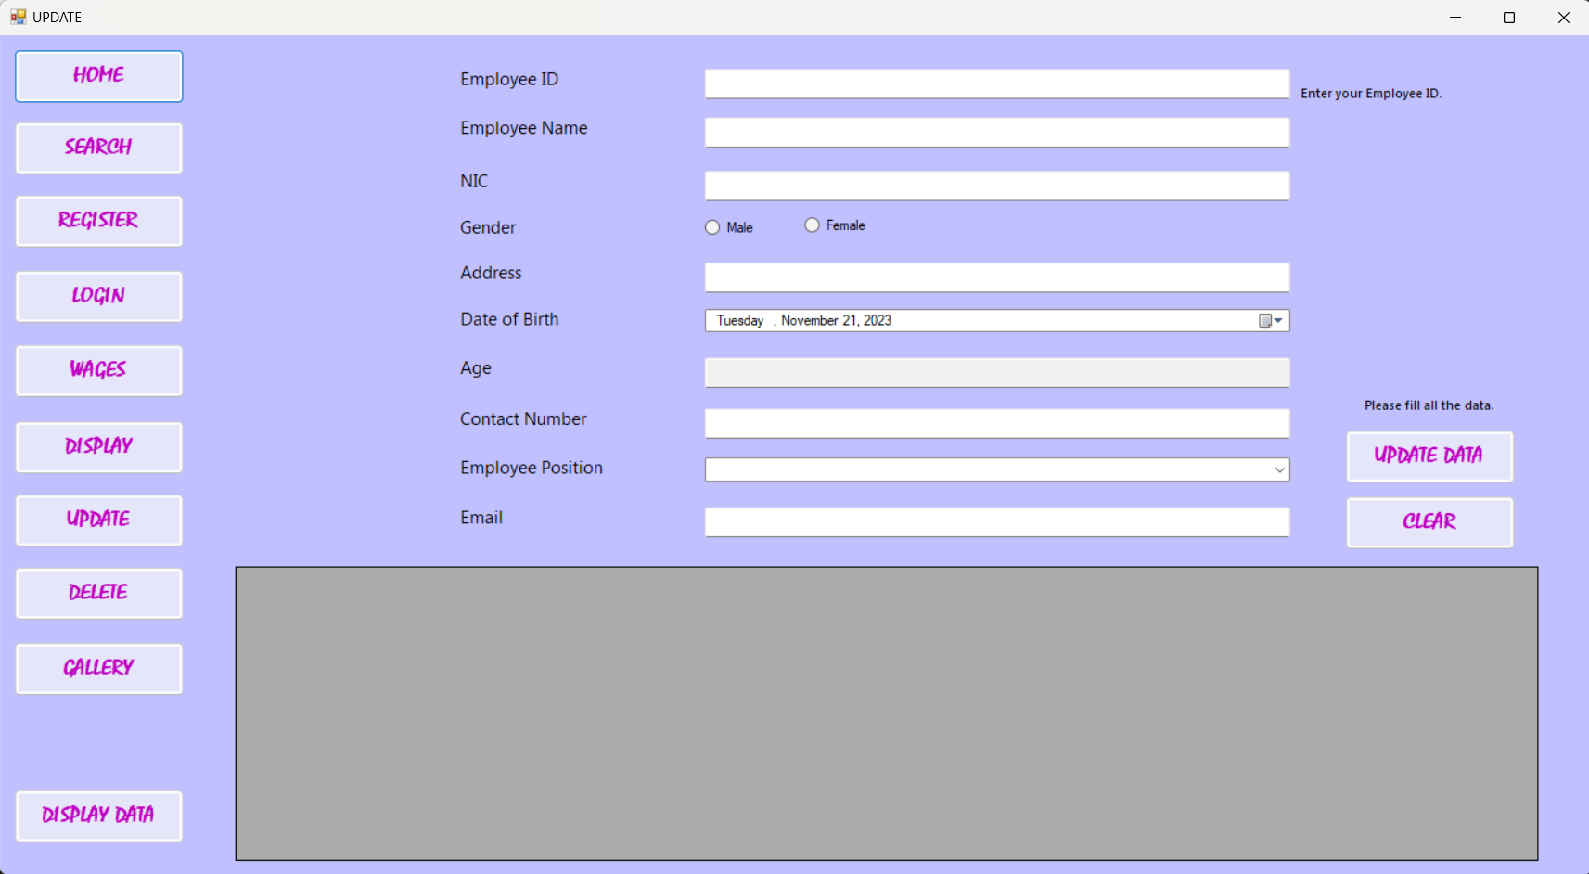
update
An employee in the system should be able to update their data.

Slide 20
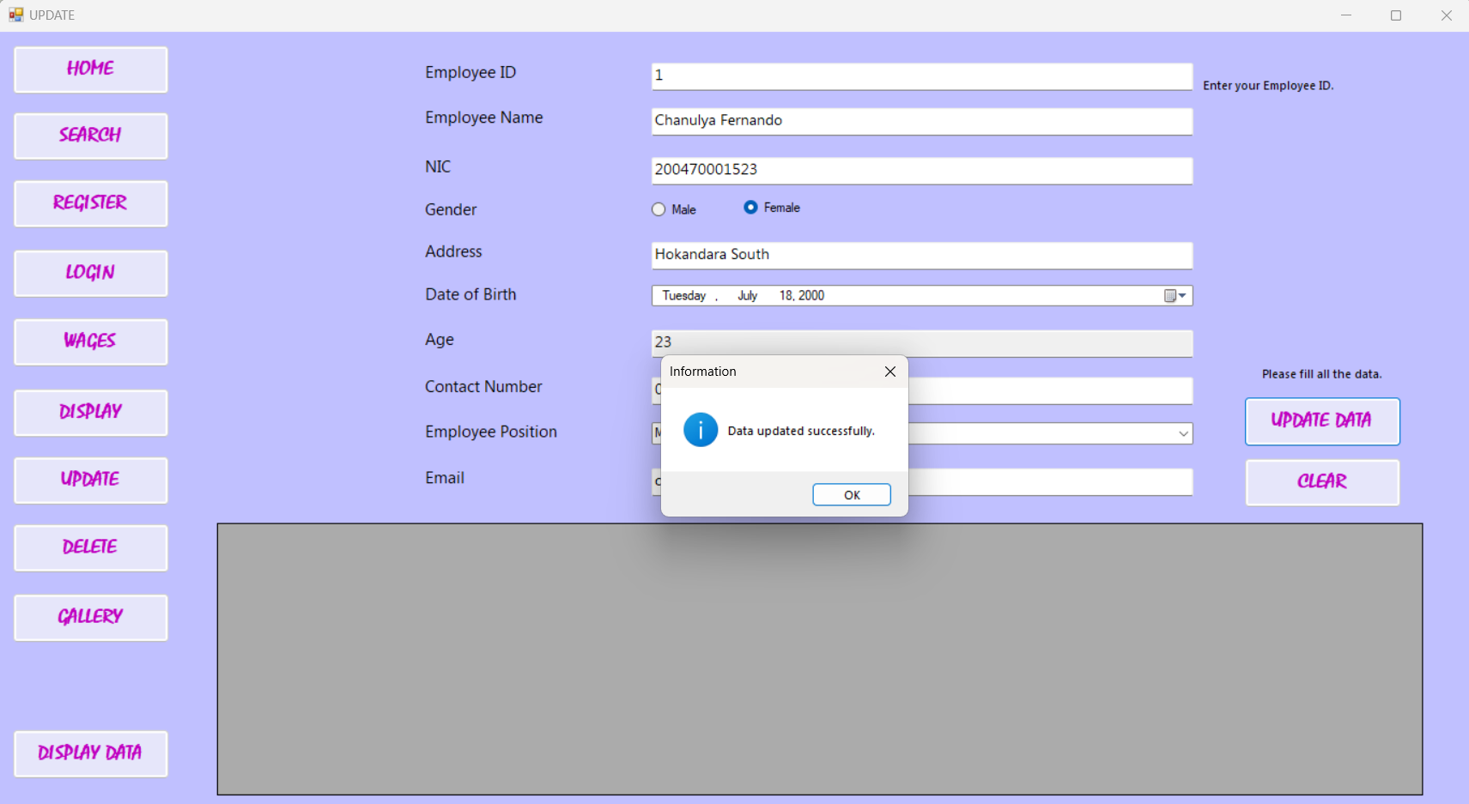
Update message
When the data is updated successfully.

Slide 21
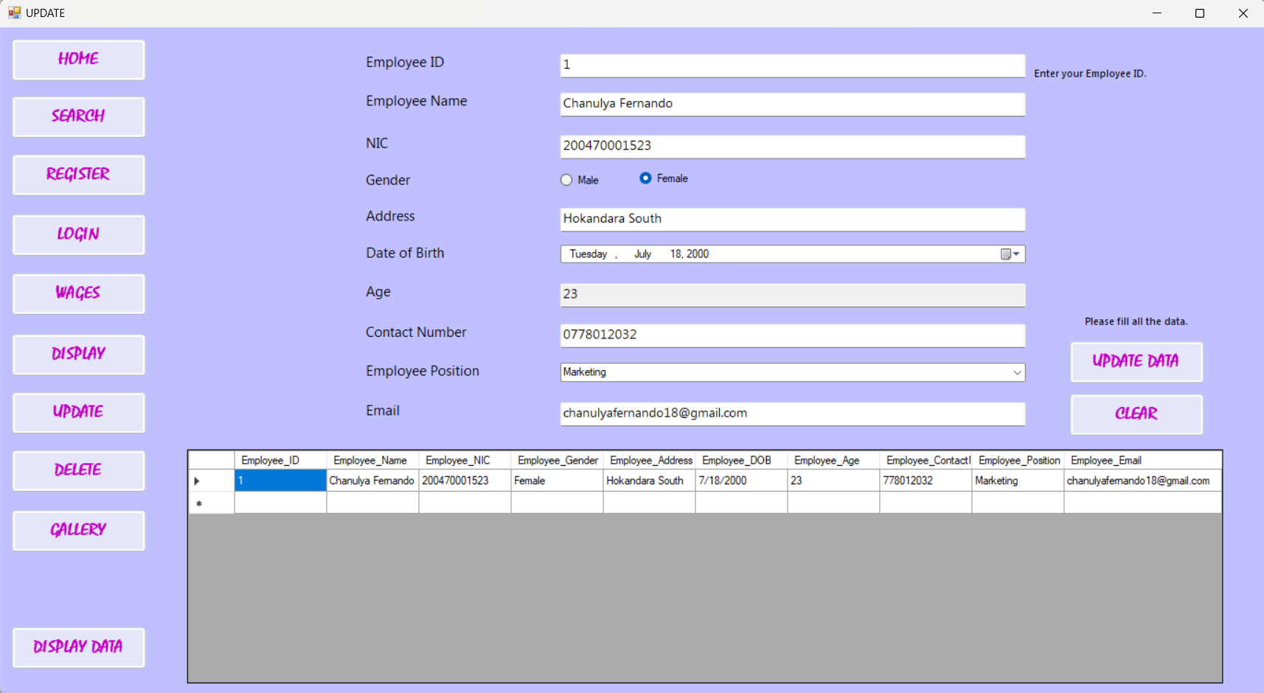
update
After entering the updated data in the fields and clicked on ‘UPDATE DATA’ the data will be updated.
And when the button ‘DISPLAY DATA’ is clicked the updated data appears in the display box.

Slide 22
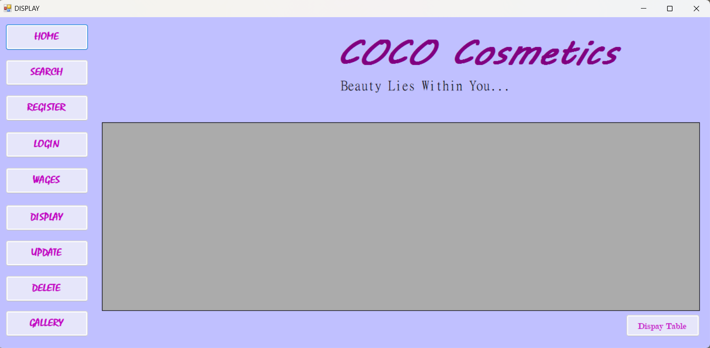
display
All the available data in the system is displayed.

Slide 23
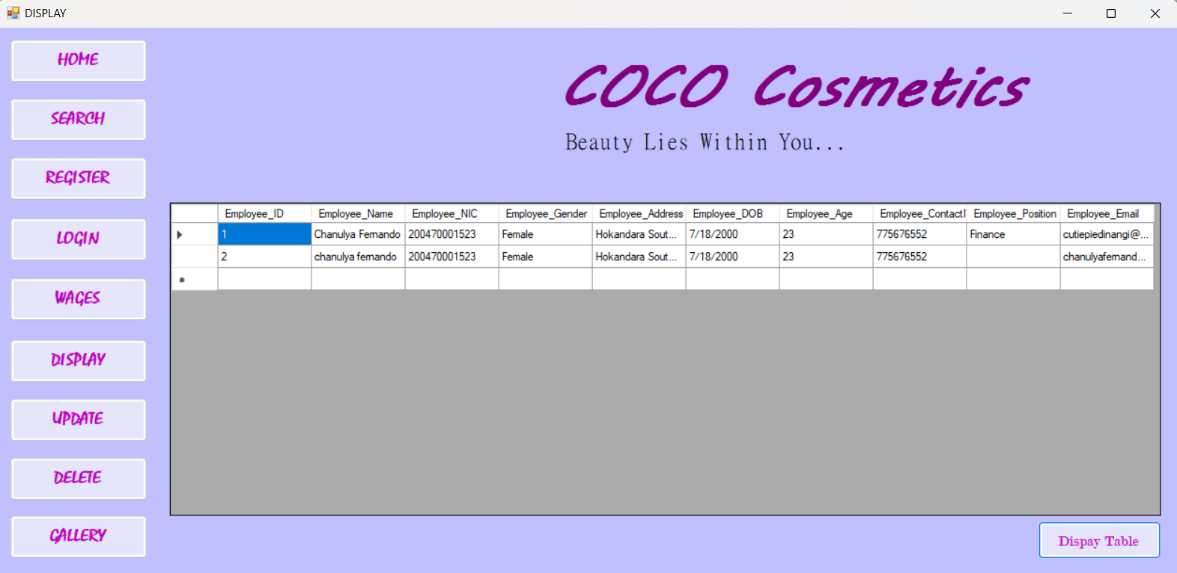
display
All data is displayed in a table.

Slide 24
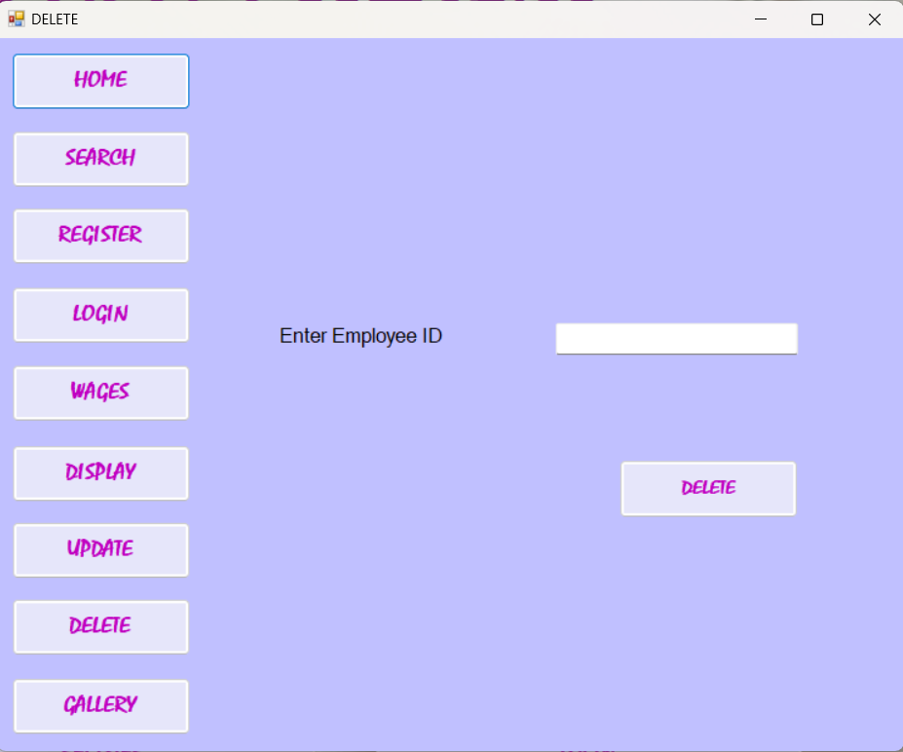
delete
Data in the system can be deleted when the ‘Employee ID’ is entered.

Slide 25
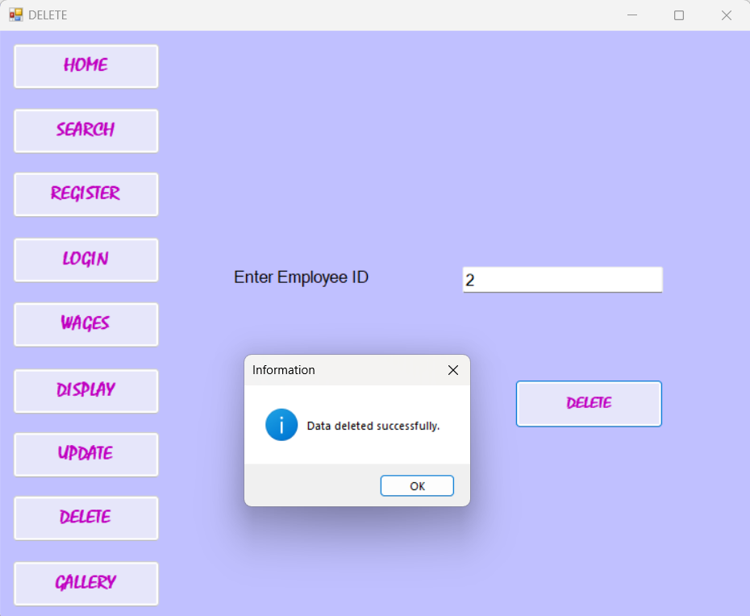
Delete message
When the data of the entered Employee ID is deleted.

Slide 26
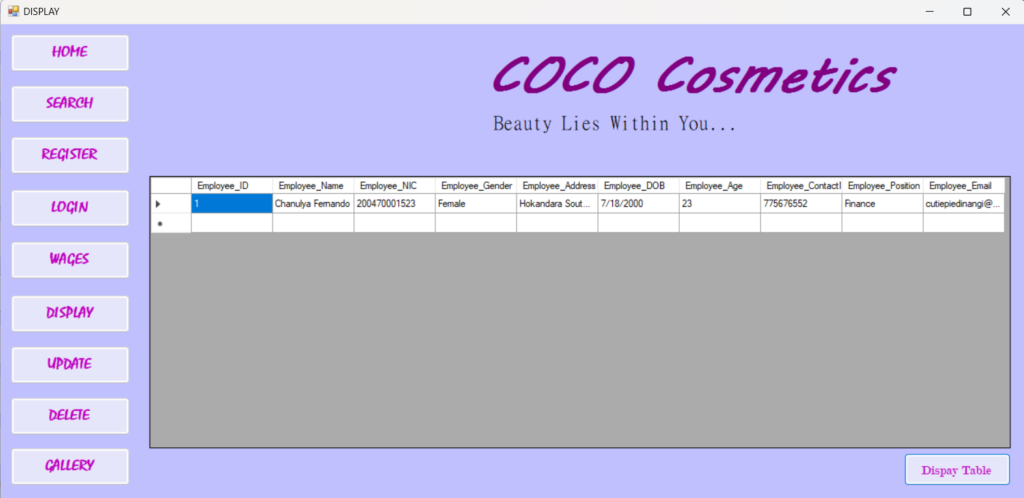
Display data after deleting
All the remaining data is displayed.

Slide 27
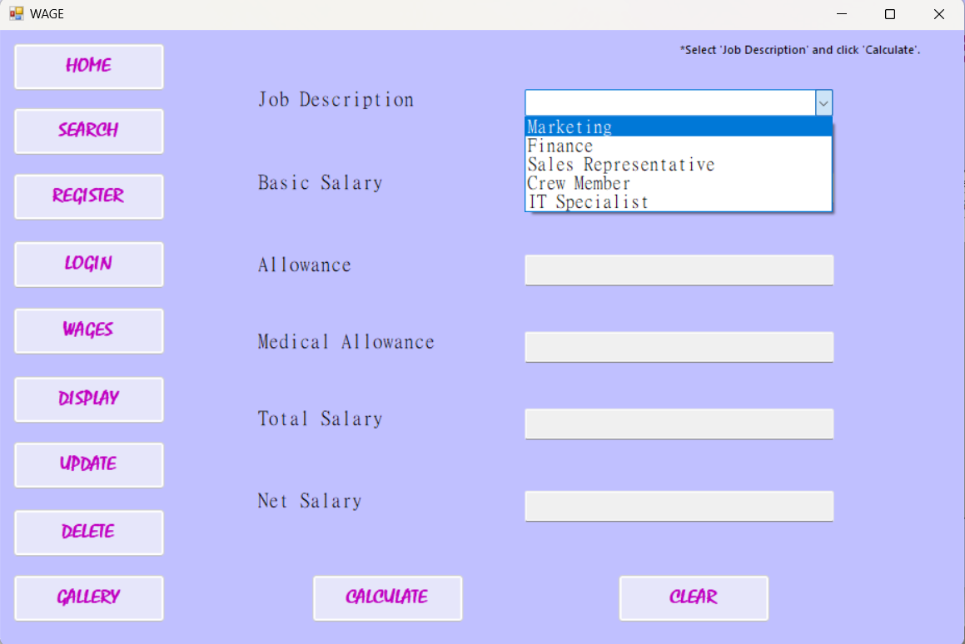
wages
Monthly salary of an employee is calculated.

Slide 28
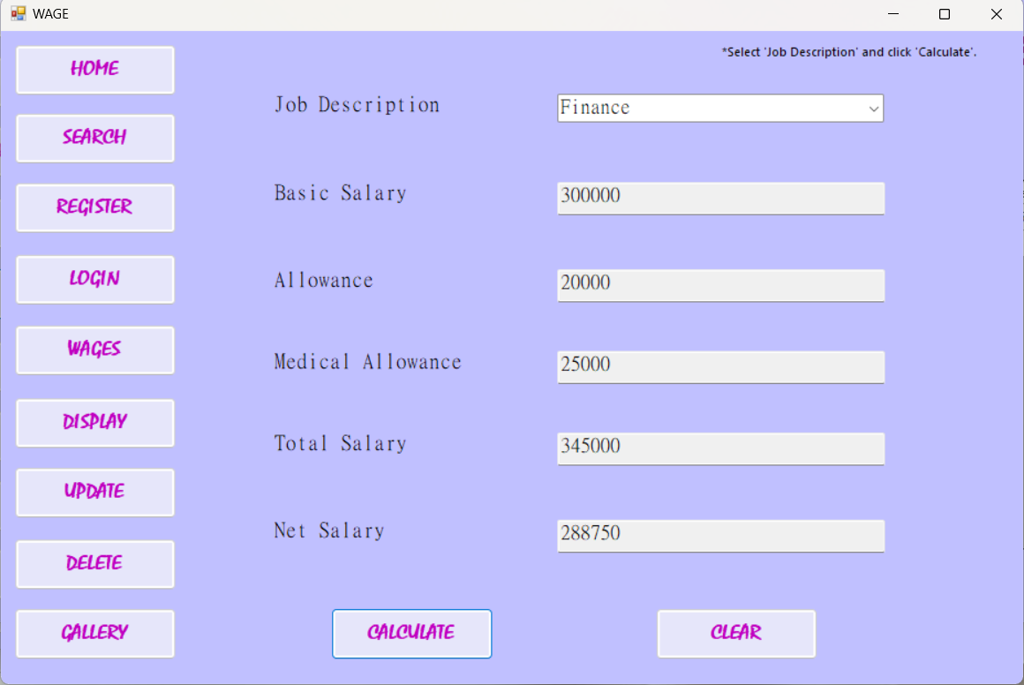
Calculating wages
Salary of the employee is calculated when the position is selected.

Slide 29
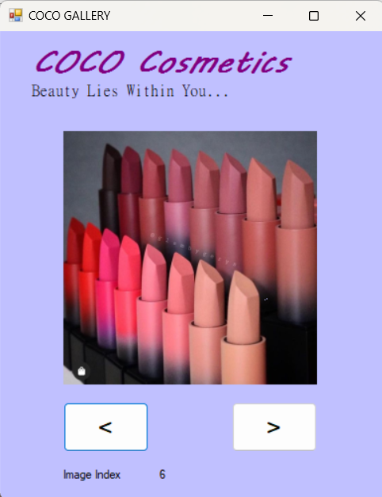
gallery
Pictures of COCO Cosmetics will be visible to the user when the button are clicked back and forth.

Slide 30
Thank you
FERNANDO L C D
(COCSE235F-039)
COCSE235F-039@student.nibm.lk

